Slide 1
Thursday, January 12, 2017
Write In Your Agenda:
Write In Your Monitoring Log:
CW:
Continue Graphing Quantitative Data.
HW:
Finish “Graphing Practice” worksheet.
Response to Warm-Up:
When would you use a line graph? When would you use a bar graph? Use your notes to help you answer the question!
You will need:
Pencil
Monitoring Log
“Gorgeous Graphs” Packet

Slide 2
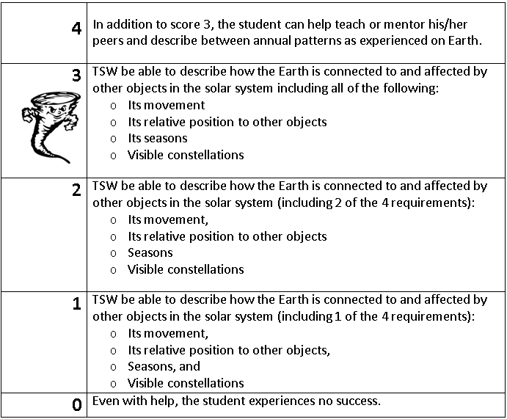
Learning Goal and Scale
TSW be able to describe how the Earth is connected to and affected by other objects in the solar system (including its movement, its relative position to other objects, its seasons, and visible constellations).

